Slide 1
BELL RINGER
Please sign up for whatever role you’d like to read.
First come, first serve!
DO NOT erase other names!

Slide 2
TYPE YOUR ANSWER INTO THE CHAT
What do you think it means to copyright something?
What kinds of things can be copyrighted?

Slide 3
BELL RINGER
LEVELS OF COURTS
District/Trial Court
Original Jurisdiction (OJ); hears cases for the first time
Juries usually decide the verdict
Court of Appeals
Appellate Jurisdiction (AJ); hears cases for the second time
Judges decide the verdict
Supreme Court
Usually “AJ,” but “OJ” in a few types of cases
Judges decide the verdict
They have final say

Slide 4
BELL RINGER
PARTS OF A TRIAL
Civil Law
Laws that deal with disputes between two people
Plaintiff
A person who brings a case against another
Defendant
Someone who is sued or accused in a court of law

Slide 5
BELL RINGER
PARTS OF A TRIAL
Opening Statement
The lawyer tells the jury what the case is about and what the evidence will show
Direct Examination
The lawyer asks the witness a set of questions
Cross-Examination
The other side’s lawyer asks a witness questions in order to point out weaknesses in the witness’s testimony

Slide 6
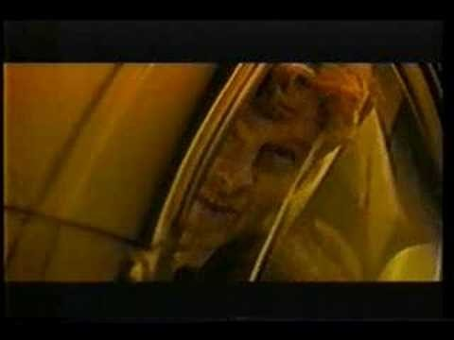
BELL RINGER
HONDA COMMERCIAL

Slide 7
BELL RINGER
VERDICT
Did Honda copy James Bond?
Go through the checklist on your handout, then make a determination.

